Slide 1

TRANSFORMING
YOUR LIFE INTO A
VIDEO GAME
BY ALI ASGHAR

Slide 2

HOW TO DO IT?
01
PHOTOGRAMMETRY
Photogrammetry or (3D-Scanning) is a 3D coordinate measuring technique that uses photos as the fundamental medium for measurement.
Notes:
Personal favourite.

Slide 3
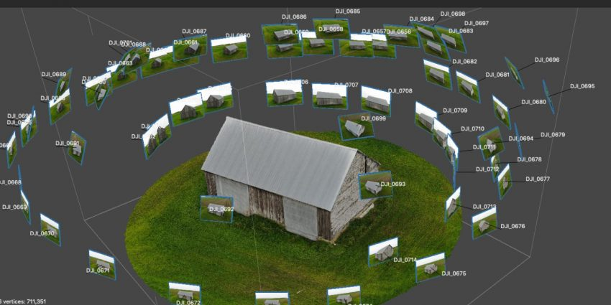
PHOTOGRAMMETRY

Slide 4

HOW TO DO IT?
01
02
PHOTOGRAMMETRY
GAME ENGINE
Photogrammetry or (3D-Scanning) is a 3D coordinate measuring technique that uses photos as the fundamental medium for measurement.
A Game Engine Like Unity. Unity is a cross-platform game engine developed by Unity Technologies
Notes:
Personal favourite.

Slide 5
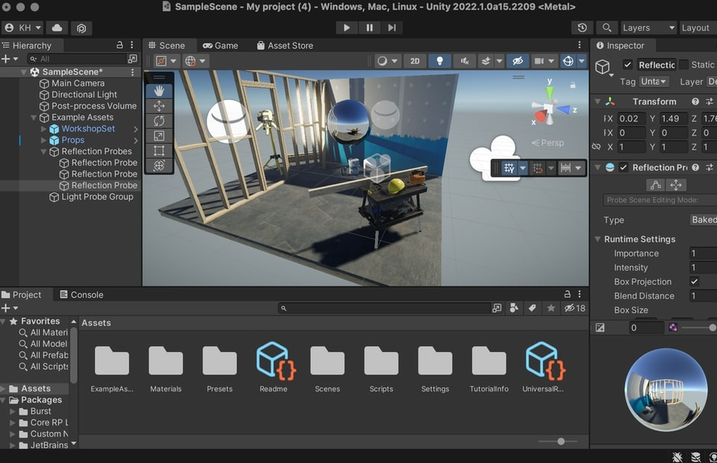
GAME ENGINE(UNITY)

Slide 6

HOW TO DO IT?
01
02
03
PHOTOGRAMMETRY
GAME ENGINE
CODING
Photogrammetry or (3D-Scanning) is a 3D coordinate measuring technique that uses photos as the fundamental medium for measurement.
A Game Engine Like Unity. Unity is a cross-platform game engine developed by Unity Technologies
Programming is essential for prototyping a game in unity. This is the last barrier in making your dream game
Notes:
Personal favourite.

Slide 7
CODING

Slide 8



WHY TRANFORM IT?
GENERATING NEW IDEAS
With the help of this transformation, We can generate new ideas about this world around us.
LIMITLESS CONTROL
We can break the chains of real world difficulties. We can have a limitless control over the virtual world.
CONNECTING THE WORLD
We can virtually connect to any part of the transformed world. We can also create our own avatars and simulate them.
And Many More….

Slide 9
THANK YOU!
I AM OPEN FOR YOUR QUESTIONS!

